Slide 1
MPCA LAB MINI PROJECT
PROJECT TITLE: HOME AUTOMATION
SECTION: B
STUDENTS NAME: ASHWINI
B.PRAVENA
BHAGYA SHREE
BHAVANA.R
SRN’s:PES2UG19CS073
PES2UG19CS076
PES2UG19CS085
PES2UG19CS089

Slide 2
PROBLEM STATEMENT
Design a system that allows users to control and monitor multiple home appliances

Slide 3
INTRODUCTION
The project focuses on the automation of electric home equipments. Automation is achieved using Aurdino along with necessary sensors.
The project involves electronic door lock, temperature control, movement sensors. Home security is essential for occupant’s convenience and protection.
This project involves to develop a low cost means of home automation system using sensors like motion sensor. PIR sensor, temperature sensor, servo motor, ultrasonic sensor, LEDs.

Slide 4
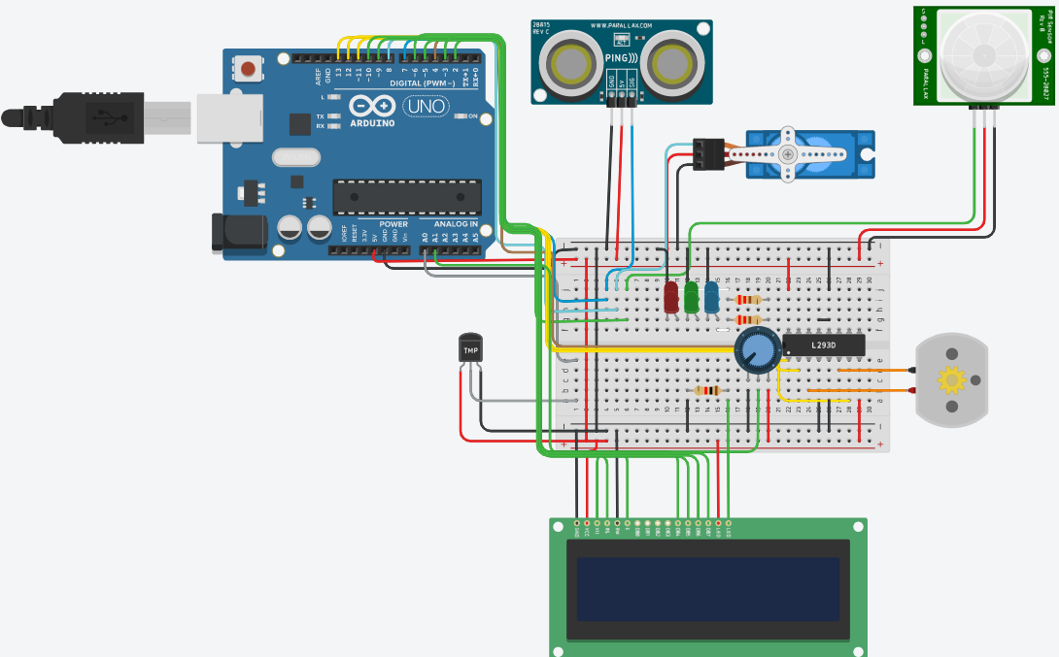
BLOCK DIAGRAM

Slide 5
REQUIRED COMPONENTS
Arduino,
ultrasonic distance sensor,
PIR sensor,
micro servo,
breadboard,
LEDs,
resistors,
potentiometer,
temperature sensor,
DC motor,
LCD

Slide 6
PROJECT DESCRIPTION
For this we have used an Ultrasonic Sensor for measuring the distance and the Servo motor for opening the door.
The door will open for 2 seconds if any person comes near the door within 40cm range

Slide 7
PROJECT DESCRIPTION
We have used a PIR Sensor for detecting movements in the room. As the PIR Sensor detects any movement LEDs will be turned on.
We have used a temperature sensor that detects the temperature. If the temperature detected is more than 20℃ then a fan (represented by a DC motor) starts to run.
The status of the 3 sensors is displayed using the LCD.

Slide 8
APPLICATIONS
Smart Home Appliances
Lighting control
Smart locks
Smart switches
Improved home safety and security

Slide 9
REFERENCES(Website links, Books etc.
https://www.youtube.com/watch?v=WSuIad9Ehd4&t=228s
https://www.youtube.com/watch?v=w84O5J1zt8I
https://www.tinkercad.com/learn/circuits

Slide 10
THANK YOU

